Slide 1
SUPPLY CHAIN
Visibility & Optimization
Milestone 4:
Warehouse efficiency reports Executive overview dashboard
Optimized dashboard performance Final tesing,documentation&deployment
Group 5 – Infosys Springboard Internship
Vijetha • Supriya • Supraja • Srilatha
03 September 2026

Slide 2
Introduction
PROJECT CONTEXT
From data preprocessing to supply chain performance optimization
SUPPLY CHAIN
VISIBILITY
ANALYTICS
Planning, sourcing, manufacturing, transport, and delivery.
Monitor inventory, suppliers, logistics, and fulfillment.
Identify bottlenecks, control costs, and improve decisions.
TOOLS USED
Python
Power BI
Data preprocessing and data-quality preparation.
Interactive dashboards and performance analysis.
Milestone 1 → Clean data • Milestone 2 → Analysis & dashboards • Milestone 3 → Advanced performance dashboards
Group 5 • Infosys Springboard Internship • Supply Chain Visibility & Optimization
3

Slide 3
Problem Statement
PROJECT CONTEXT
Common challenges in supply chain operations
Stock
Delivery
Cost
Shortages and excess inventory
Delays and logistics inefficiencies
Higher operational expenses
Planning
Quality
Customer
Inefficient inventory planning
Supplier and product quality issues
Reduced customer satisfaction
Aim
Analyze supply chain performance, identify inefficiencies, and support data-driven optimization.
Group 5 • Infosys Springboard Internship • Supply Chain Visibility & Optimization
4

Slide 4
Objectives
PROJECT CONTEXT
What we aim to achieve
01
02
Understand and analyze the supply chain dataset.
Identify and resolve data-quality issues using Python.
03
04
Perform exploratory data analysis to identify patterns and trends.
Develop interactive Power BI dashboards for supply chain analysis.
05
06
Evaluate supplier, transportation, route, and carrier performance.
Combine key performance indicators to generate actionable optimization insights.
Group 5 • Infosys Springboard Internship • Supply Chain Visibility & Optimization
5

Slide 5
Milestone 1: Dataset Overview
MILESTONE 1
Supply chain dataset used for analysis
1,540
24
Supply Chain
Records
Attributes
Domain
Product
Logistics
Supplier & Manufacturing
Type • SKU • Price • Availability • Products Sold • Revenue
Shipping Time • Carrier • Shipping Cost • Transportation Mode • Route
Supplier • Manufacturing Cost • Lead Time • Inspection • Defect Rate
Purpose
Provide the data foundation for preprocessing, analysis, and dashboard development.
Group 5 • Infosys Springboard Internship • Supply Chain Visibility & Optimization
6

Slide 6
Milestone 1: Data Preprocessing
MILESTONE 1
Preparing a clean and reliable dataset
1. Import
2. Quality Check
3. Data Cleaning
4. Validation
5. Export
Load raw dataset
→
Missing values, duplicates, formatting
→
Clean and standardize
→
Verify cleaned data
→
Prepare final dataset
Data-quality checks
Missing values • Duplicates • Data types • Formatting
Output
MILESTONE 1 OUTCOME
Clean, structured dataset ready for EDA and Power BI analysis.
Clean & reliable dataset for analysis.
Group 5 • Infosys Springboard Internship • Supply Chain Visibility & Optimization
8

Slide 7
Milestone 1: EDA – Complete Process
MILESTONE 1
Exploratory Data Analysis before deeper business analysis
Definition
Examining, summarizing, cleaning, visualizing, and analyzing data to discover useful relationships.
Understand Data
Quality Check
Cleaning
Univariate / Bivariate / Multivariate Analysis
Statistical Analysis
Visualization
Find Patterns
Business Insights
MILESTONE 1 OUTCOME
Cleaned and analyzed data ready for dashboard development.
Group 5 • Infosys Springboard Internship • Supply Chain Visibility & Optimization
9

Slide 8
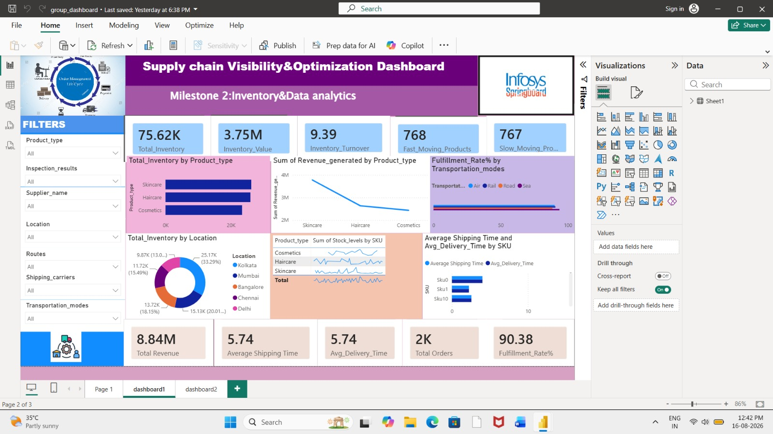
Milestone 2: Dashboard 1 – Supply Chain KPIs
MILESTONE 2
Monitor overall inventory, revenue, shipping, and fulfillment performance
KEY METRICS
75.62K
3.75M
Total Inventory
Inventory Value
9.39
8.84M
Inventory Turnover
Total Revenue
5.74 days
90.38%
Avg. Shipping Time
Fulfillment Rate
Existing Power BI dashboard screenshot
Group 5 • Infosys Springboard Internship • Supply Chain Visibility & Optimization
11

Slide 9
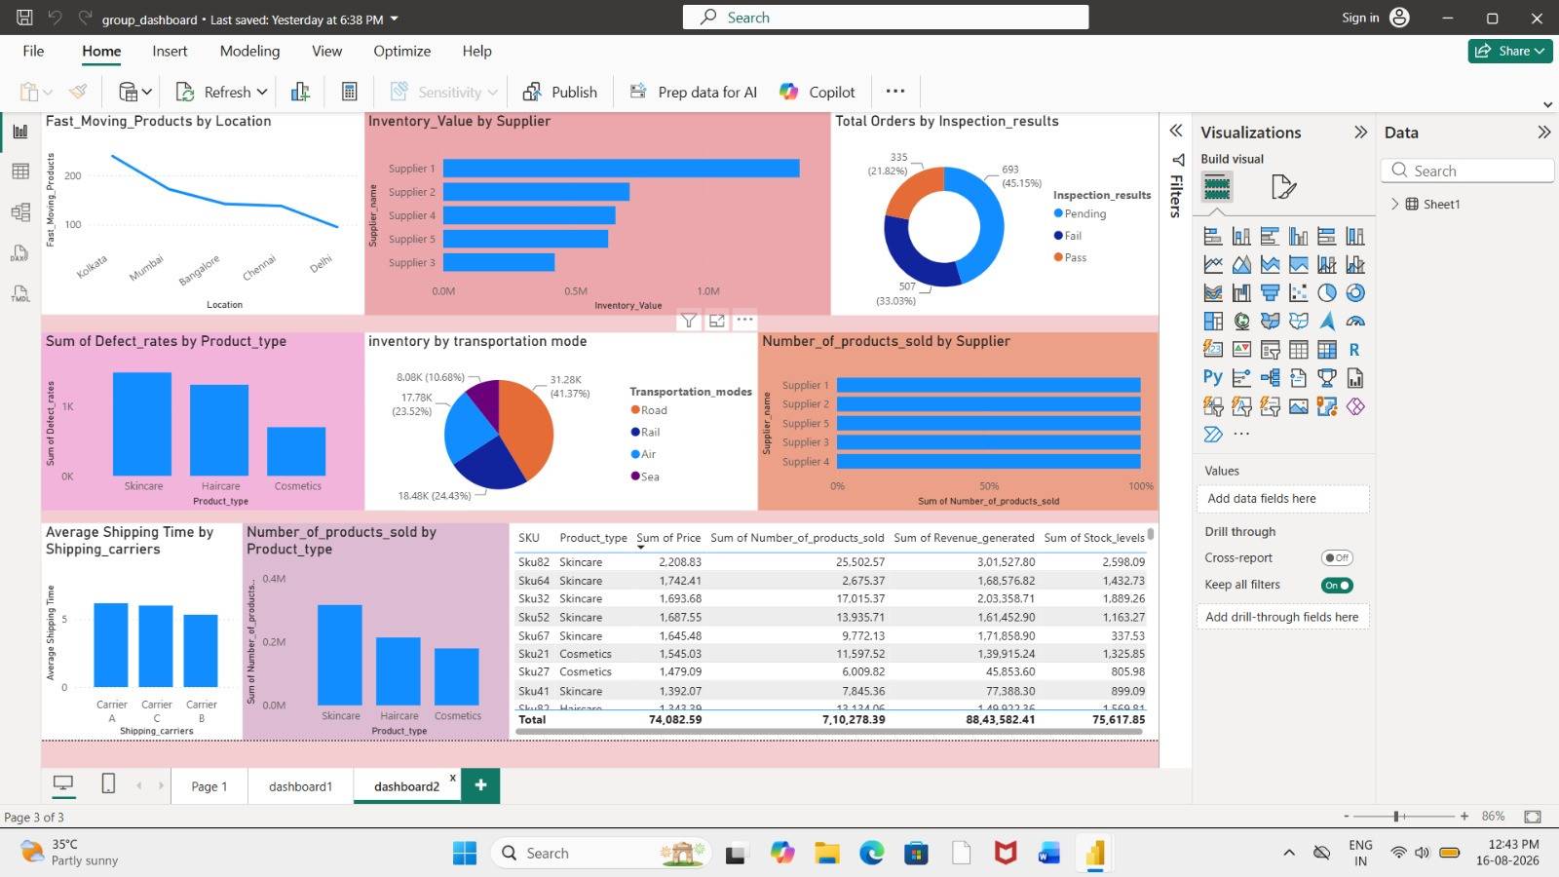
Milestone 2: Dashboard 2 – Product & Supplier Analysis
MILESTONE 2
Compare product, supplier, quality, and transportation performance
KEY OBSERVATIONS
Supplier 1: Highest inventory value
Cosmetics: Higher defect values
Pending Inspections: 45.15%
Road Inventory Share: 41.37%
Sales by Supplier & Product Type: Itemized tracking
Carrier Comparison: Shipping time comparison
Existing Power BI dashboard screenshot
Group 5 • Infosys Springboard Internship • Supply Chain Visibility & Optimization
12

Slide 10
Milestone 2: Key Insights
MILESTONE 2
Key observations from the existing Power BI analysis
Inventory
Transportation
Skincare contributes strongly to inventory and revenue.
Road has the largest inventory share (41.37%).
Fulfillment
Shipping
On-time fulfillment is 90.38%.
Average shipping time is 5.74 days.
Supplier
Quality
Supplier 1 has the highest inventory value.
Cosmetics show comparatively higher defect values.
Group 5 • Infosys Springboard Internship • Supply Chain Visibility & Optimization
13

Slide 11
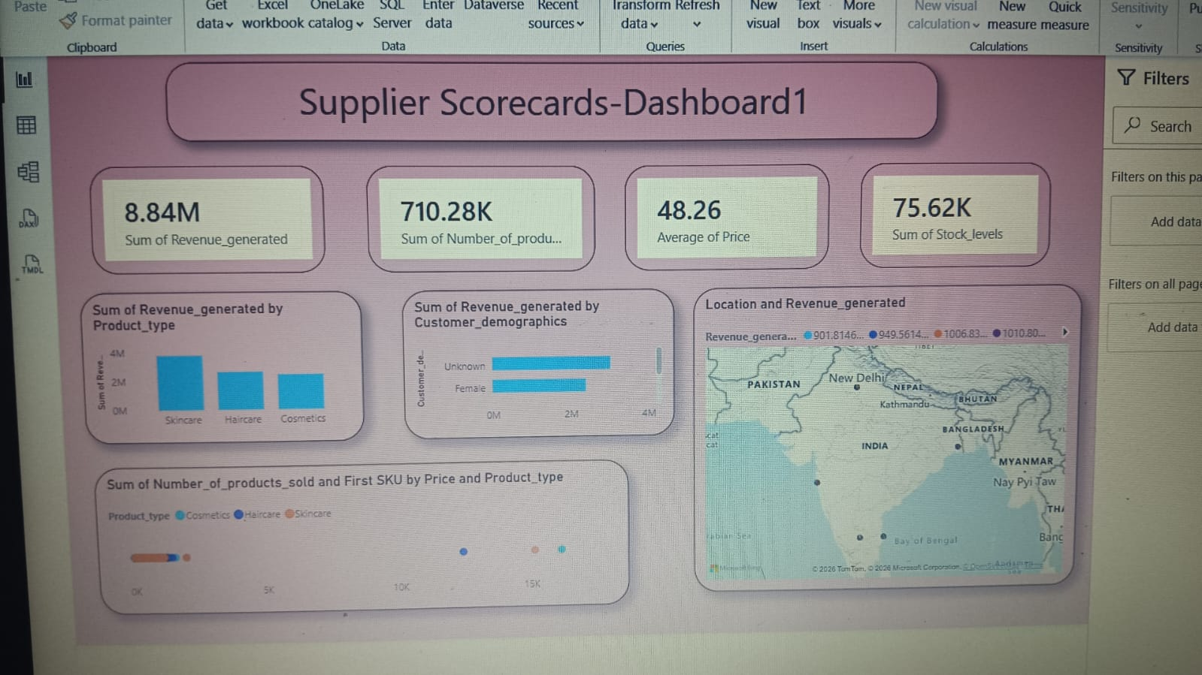
Milestone 3: Supplier Scorecards – Overview
MILESTONE 3
Main question: Which suppliers are performing well and which need improvement?
Evaluation Criteria
Revenue • Products Sold • Average Price • Stock Levels • Product Type
What This Dashboard Shows
Revenue 8.84M • Products Sold 710.28K • Average Price 48.26 • Stock Levels 75.62K
Purpose
Summarizes supplier-related sales, product and stock performance in one view.
Group 5 • Infosys Springboard Internship • Supply Chain Visibility & Optimization
14

Slide 12
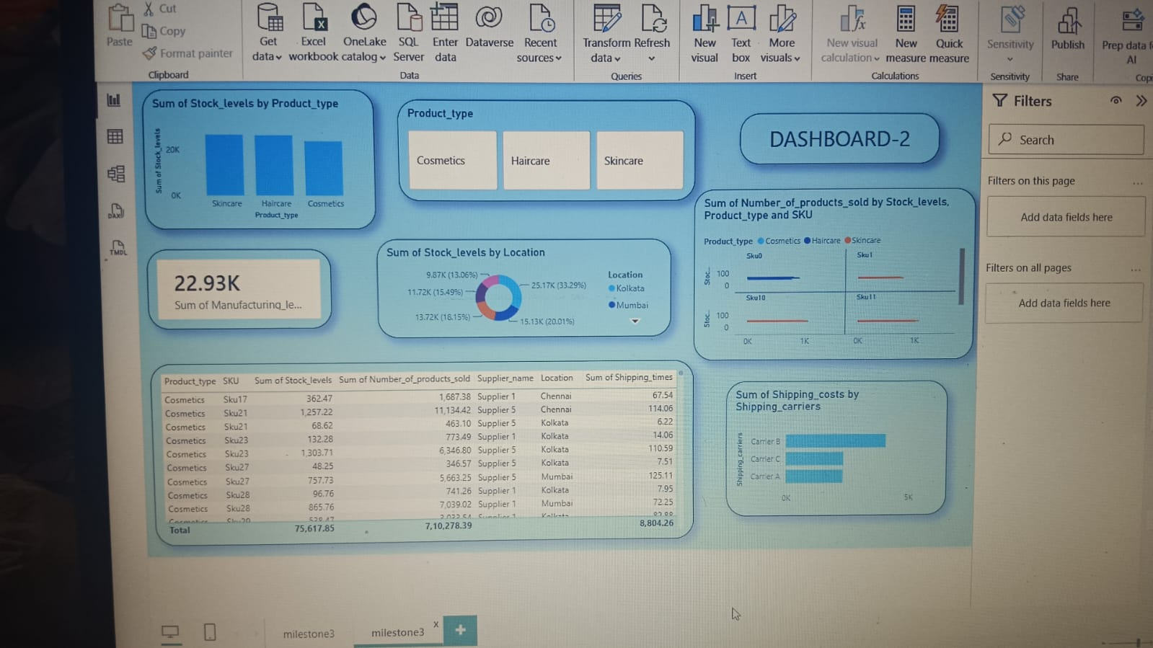
Milestone 3: Supplier Scorecards – Detailed Analysis
MILESTONE 3
Granular view of stock distribution, product contribution, and supplier logistics
What This Dashboard Shows
Stock by product type and location, SKU/product detail, supplier records and shipping cost by carrier.
Analysis Focus
Compare stock distribution, product contribution and logistics indicators across suppliers and locations.
Purpose
Provides a detailed supplier/product view for identifying areas that need attention.
Group 5 • Infosys Springboard Internship • Supply Chain Visibility & Optimization
15

Slide 13
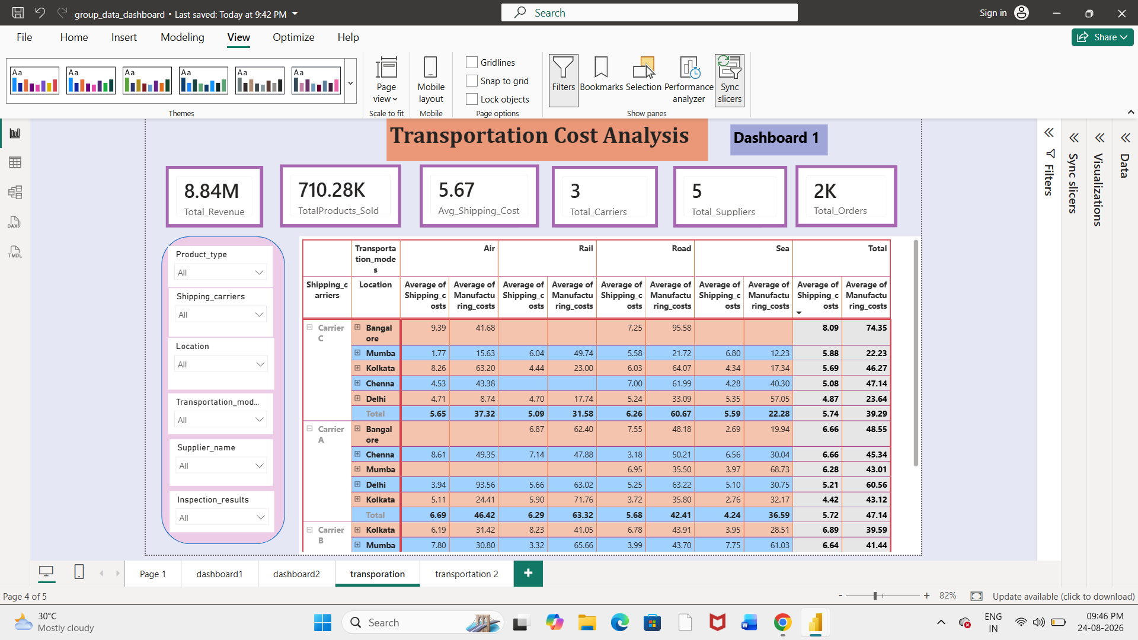
Milestone 3: Transportation Cost Analysis
MILESTONE 3
Main question: Where are we spending the most on transportation?
What This Dashboard Shows
Average Shipping Cost 5.67 • Total Revenue 8.84M • 3 Carriers • 5 Suppliers • About 2K Orders
Key Dimensions
Transportation Mode • Location • Carrier • Supplier • Product
Purpose
Shows where transportation spending is concentrated and supports cost comparison.
Group 5 • Infosys Springboard Internship • Supply Chain Visibility & Optimization
17

Slide 14
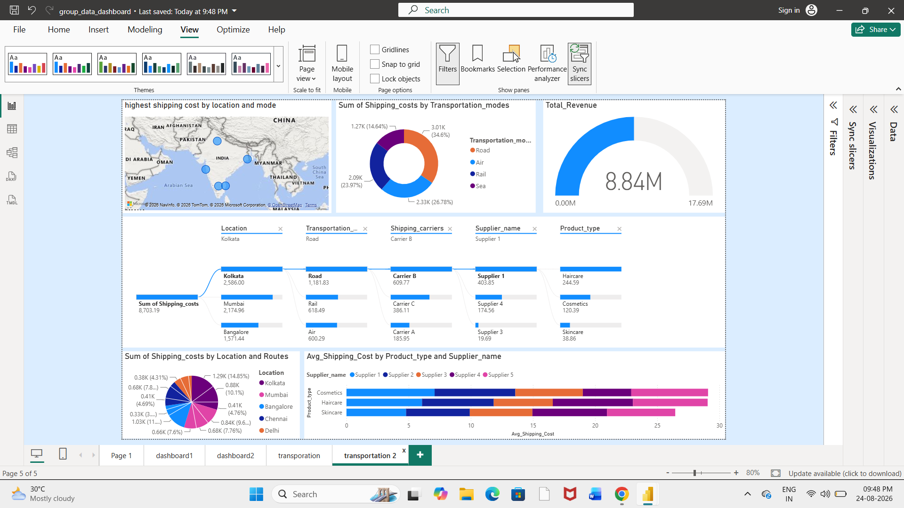
Milestone 3: Transportation Cost – Detailed Analysis
MILESTONE 3
Explore specific drivers generating high transportation expenses
What This Dashboard Shows
Shipping cost by transportation mode, location, carrier, route, supplier and product.
Analysis Focus
Compare transportation cost across multiple dimensions to locate major cost drivers.
Purpose
Uses comparisons and decomposition to locate major transportation cost drivers.
Group 5 • Infosys Springboard Internship • Supply Chain Visibility & Optimization
18

Slide 15
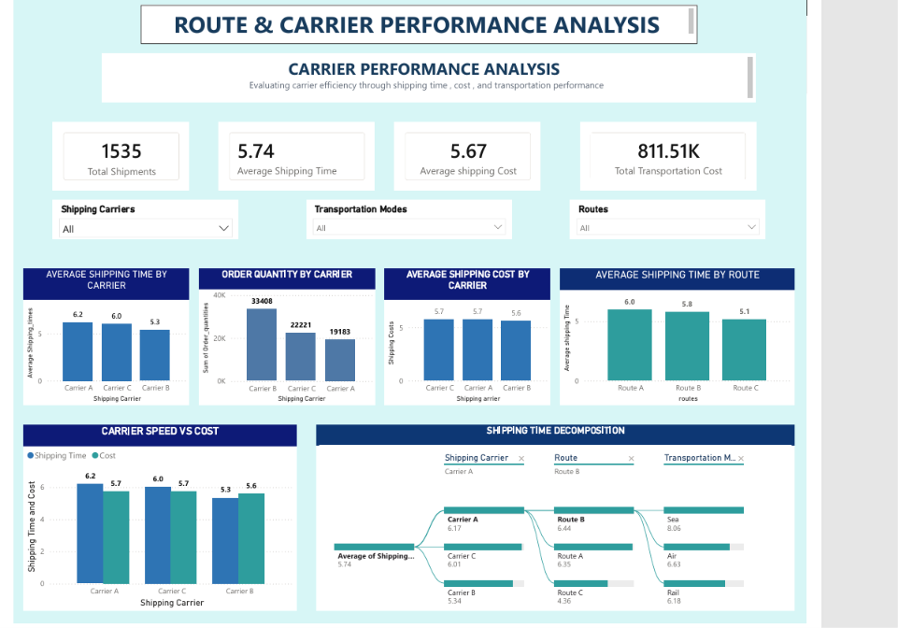
Milestone 3: Route & Carrier Performance
MILESTONE 3
Carrier Performance Analysis — compare carrier speed, cost and shipping quantity.
Key KPIs
Total Shipments 1,535 • Avg Shipping Time 5.74 • Avg Shipping Cost 5.67 • Total Transportation Cost 811.51K
What This Dashboard Shows
Carrier shipping time/cost, route shipping time, carrier speed vs cost, order quantity and shipping-time decomposition.
Purpose
Compares carrier and route performance using a common KPI framework.
Group 5 • Infosys Springboard Internship • Supply Chain Visibility & Optimization
20

Slide 16
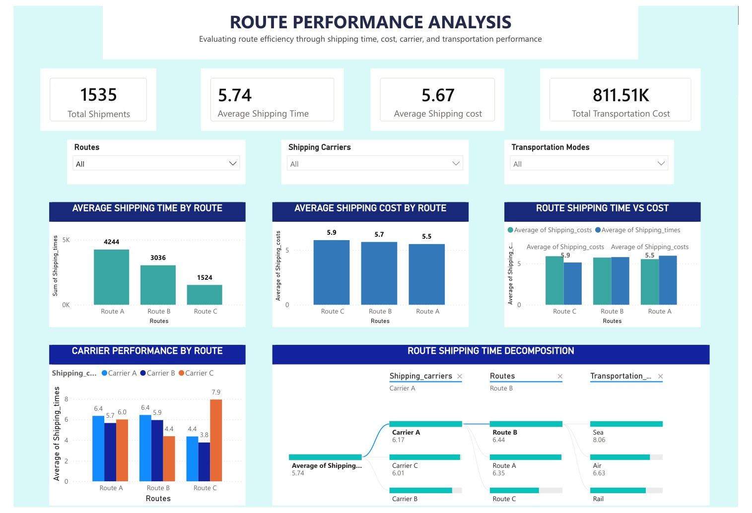
Milestone 3: Route & Carrier Performance – Detailed Analysis
MILESTONE 3
Route Performance Analysis — compare route speed, cost and carrier efficiency.
What This Dashboard Shows
Route-level shipping time and cost, route speed-vs-cost comparisons, decomposition and carrier performance by route.
Analysis Focus
Balance delivery speed and shipping cost rather than evaluating either measure alone.
Purpose
Supports evidence-based route and carrier selection.
Group 5 • Infosys Springboard Internship • Supply Chain Visibility & Optimization
21

Slide 17
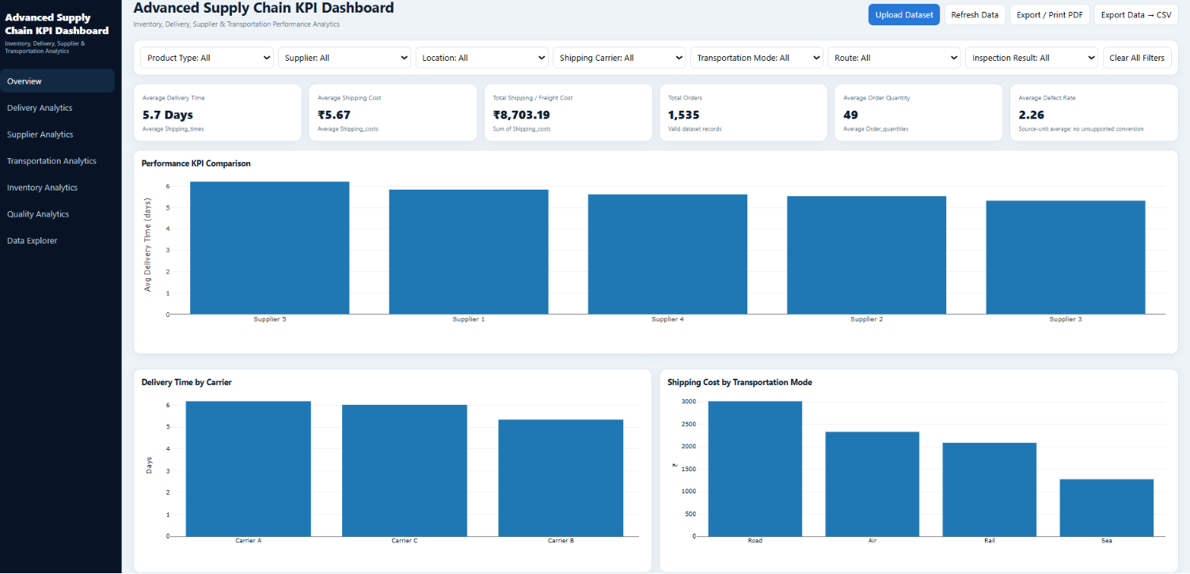
Milestone 3: Advanced KPI Visualization
MILESTONE 3
How can supply-chain KPIs be combined for quick performance analysis and decision-making?
KEY KPIs
On-Time Delivery %
Cost per Shipment
Average Delivery Time
Supplier Rating
Freight Cost
Purpose: Consolidate core supply chain metrics into a single screen.
Group 5 • Infosys Springboard Internship • Supply Chain Visibility & Optimization
23

Slide 18
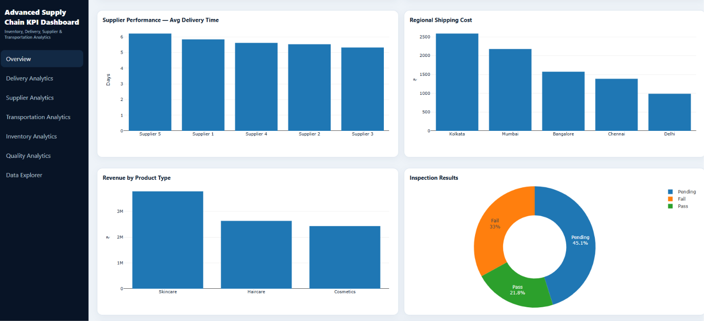
Milestone 3: Advanced KPI Visualization – Detailed Analysis
MILESTONE 3
Broader view connecting supplier, regional, revenue, and inspection metrics
What This Dashboard Shows
Supplier delivery performance, regional shipping cost, revenue by product type and inspection results.
Analysis Focus
Connect delivery, cost, revenue and quality indicators in one view.
Purpose
Provides a broader end-to-end view of supply chain performance.
Group 5 • Infosys Springboard Internship • Supply Chain Visibility & Optimization
24

Slide 19
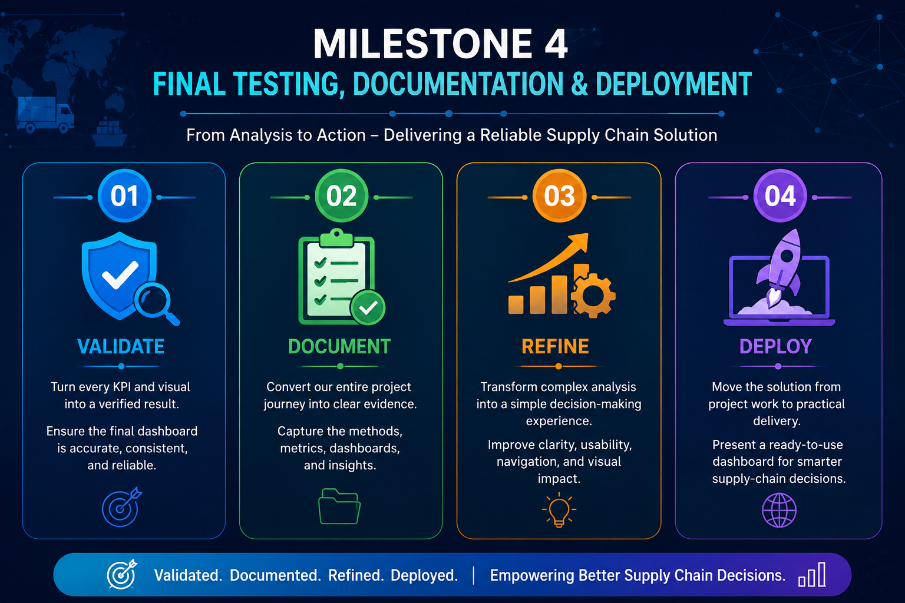
Milestone 4 – Developing, Optimizing, Testing and Deployment
MILESTONE 4
. Ensure the final dashboard is accurate, consistent, and reliable.
01 | Validate 🔍 Turn every KPI and visual into a verified result. Ensure the final dashboard is accurate, consistent, and reliable.
02 | Document 📘 Convert our entire project journey into clear evidence. Capture the methods, metrics, dashboards, and insights.
03 | Refine ⚡ Transform complex analysis into a simple decision-making experience. Improve clarity, usability, navigation, and visual impact.
04 | Deploy 🚀 Move the solution from project work to practical delivery. Present a ready-to-use dashboard for smarter supply-chain decisions.
Group 5 • Infosys Springboard Internship • Supply Chain Visibility & Optimization
24

Slide 20
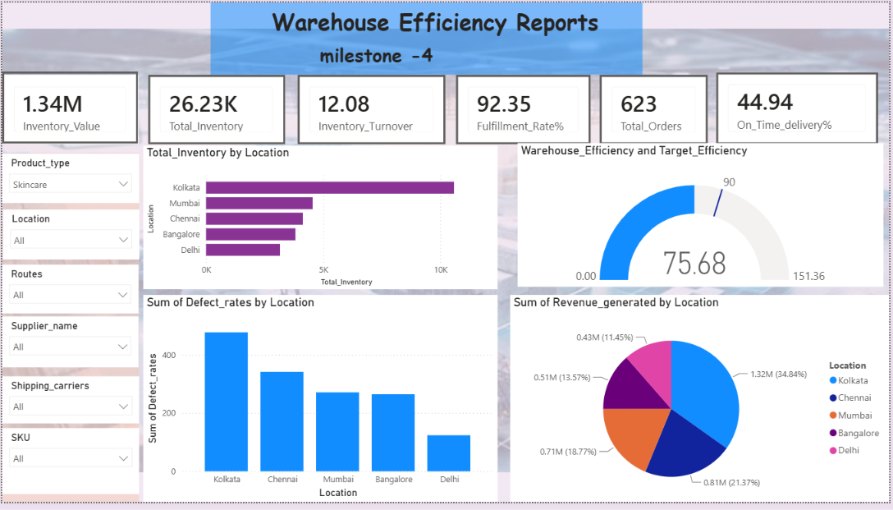
Milestone 4: Warehouse Efficiency Reports
MILESTONE 4
Broader view connecting supplier, regional, revenue, and inspection metrics
What This Dashboard Shows
Inventory, fulfillment, orders, delivery, revenue, and defect performance across locations.
.
Analysis Focus
Compare inventory efficiency, revenue, defect rates, and fulfillment performance by location and key supply-chain dimensions.
Purpose
Provide a centralized view to identify efficiency gaps and support data-driven supply-chain decisions.
Group 5 • Infosys Springboard Internship • Supply Chain Visibility & Optimization
24

Slide 21
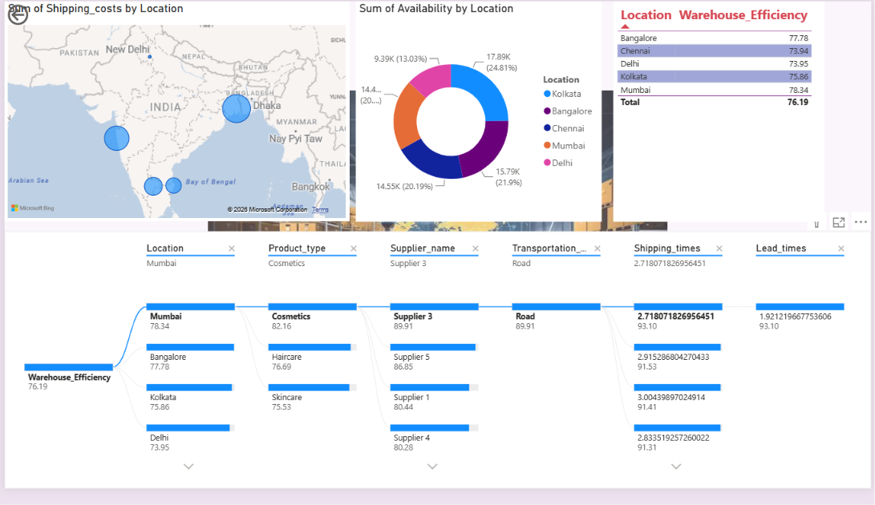
Milestone 4: Warehouse Efficiency Reports
MILESTONE 4
Dashboard ii
What This Dashboard Shows
Warehouse efficiency, shipping costs, product availability, and location-level performance..
Analysis Focus
Compare warehouse efficiency across locations and drill down by product type, supplier, transportation mode, and shipping time.
Purpose
Identify location and supply-chain factors affecting warehouse efficiency for better operational decisions.
Group 5 • Infosys Springboard Internship • Supply Chain Visibility & Optimization
24

Slide 22
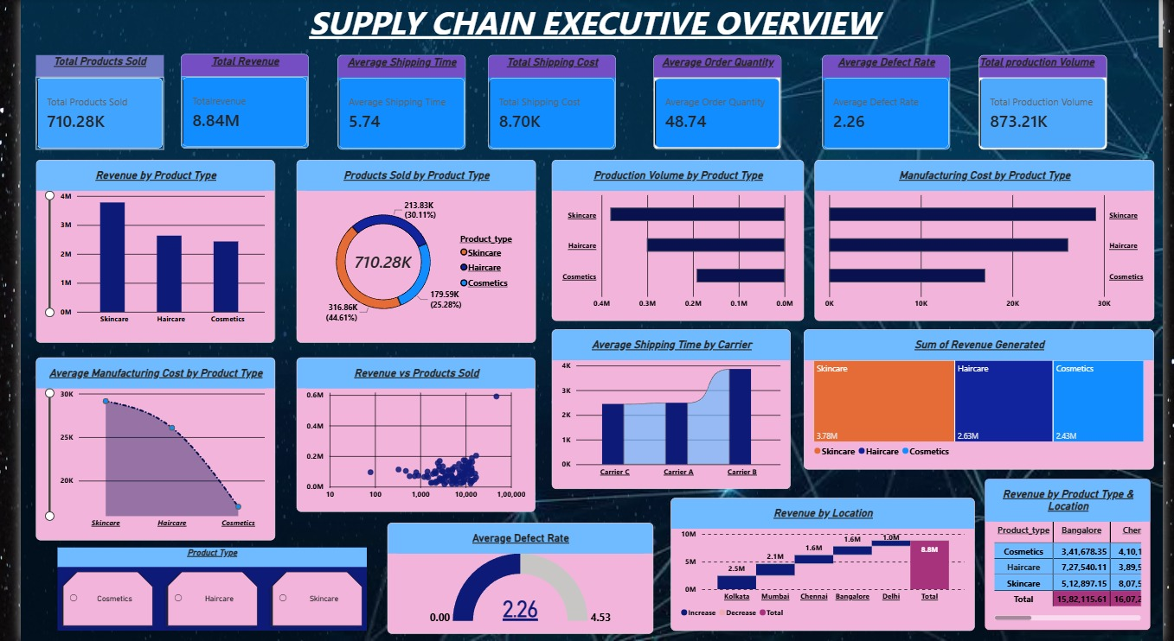
Milestone 4: Supply Chain Executive Overview
MILESTONE 4
Dashboard 2
What This Dashboard Shows
Overall supply-chain performance across sales, revenue, production, manufacturing, shipping, quality, and location.
Analysis Focus
Compare product types, carriers, locations, shipping time, revenue, production volume, manufacturing cost, and defect rate.
Purpose
Provide an executive-level view of key supply-chain KPIs to identify performance gaps and support data-driven decisions
Group 5 • Infosys Springboard Internship • Supply Chain Visibility & Optimization
24

Slide 23
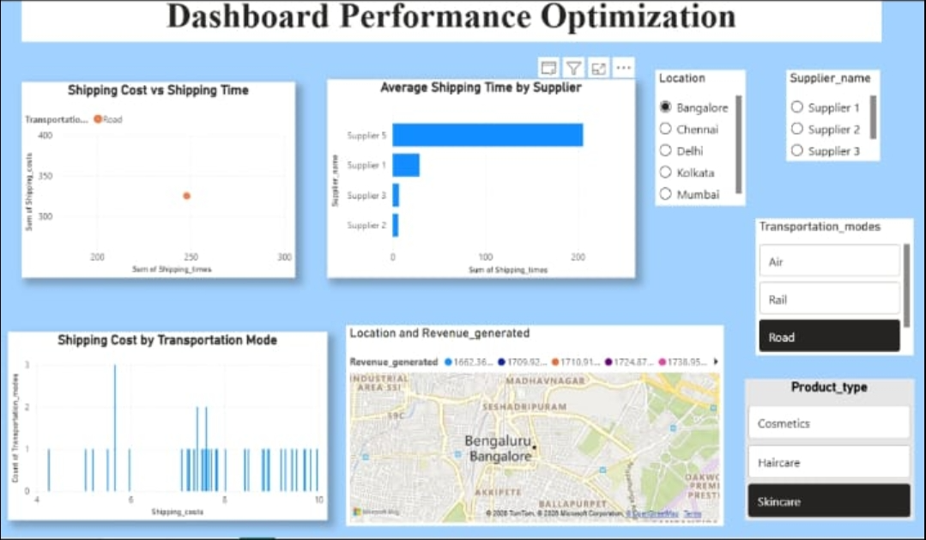
Milestone 4:Optimize Dashboard Performance
MILESTONE 4
Dashboard 3
Shipping cost, shipping time, supplier performance, transportation modes, revenue, and location-level analysis
What This Dashboard Shows
Shipping cost, shipping time, supplier performance, transportation modes, revenue, and location-level analysis.
Analysis Focus
.
Examine cost–time relationships and compare suppliers, locations, transportation modes, and product types using interactive filters.
Purpose
Optimize dashboard-driven supply-chain decisions by identifying cost patterns, efficiency gaps, and key performance factors.
Group 5 • Infosys Springboard Internship • Supply Chain Visibility & Optimization
24

Slide 24
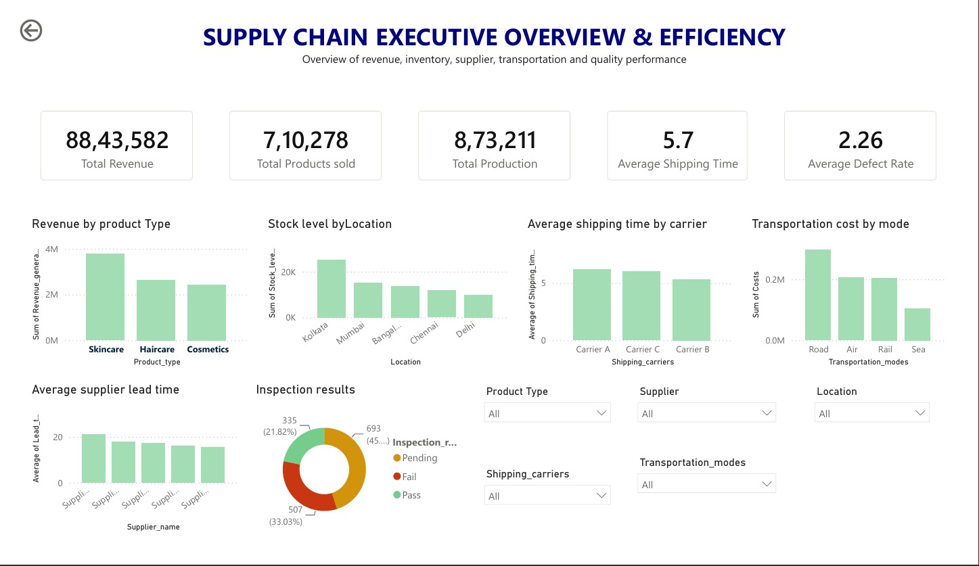
Milestone 4:Final Testing, Documentation & Deployment
MILESTONE 4
Dashboard 4
What This Dashboard Shows
Executive-level performance across revenue, products, production, inventory, shipping, suppliers, transportation, and quality.
Analysis Focus
.
Compare product, location, carrier, supplier, transportation mode, lead time, and inspection performance.
Purpose
Provide a centralized view of supply-chain efficiency to identify performance gaps and support better decisions.
Group 5 • Infosys Springboard Internship • Supply Chain Visibility & Optimization
24

Slide 25
Overall Key Insights
PROJECT OUTCOMES
Integrated insights across all three milestones
Supplier Performance
Transportation Cost
Multi-metric supplier evaluation helps identify supplier strengths and improvement areas.
Mode-, location-, and carrier-level analysis helps identify major transportation cost drivers.
Route & Carrier Performance
Advanced KPI Visualization
Combining shipping time and cost supports balanced route and carrier selection.
Integrated KPIs provide a consolidated view of operational performance and supply-chain bottlenecks.
Group 5 • Infosys Springboard Internship • Supply Chain Visibility & Optimization
26

Slide 26
Key Findings & Recommendations
PROJECT OUTCOMES
Turning dashboard analysis into practical actions
Key Findings
Recommendations
Supplier Performance: Supplier performance varies across sales contribution, stock levels, product contribution, and logistics indicators.
Transportation Cost: Transportation costs differ across modes, locations, and carriers, highlighting major cost drivers.
Route & Carrier Performance: Shipping speed and transportation cost together reveal important route and carrier trade-offs.
Advanced KPI Visualization: Integrated KPIs provide a consolidated view of operational performance and supply-chain bottlenecks.
Supplier Performance: Continuously monitor supplier performance using multiple performance indicators.
Transportation Cost: Review high-cost transportation routes and modes to identify optimization opportunities.
Route & Carrier Performance: Select routes and carriers by balancing shipping cost with delivery speed.
Advanced KPI Visualization: Use interactive KPI dashboards for ongoing supply-chain performance monitoring.
Focus: Improve visibility → identify bottlenecks → optimize decisions → monitor performance.
Group 5 • Infosys Springboard Internship • Supply Chain Visibility & Optimization
27

Slide 27
Conclusion & Future Scope
PROJECT OUTCOMES
From raw data to actionable supply chain performance insights
Milestone 1 – Data Preprocessing
Established a clean and structured dataset for analysis.
Milestone 2 – Supply Chain Analysis
Used EDA and Power BI to identify patterns and monitor operational KPIs.
Milestone 3 – Advanced Dashboards
Evaluated supplier, transportation, route, carrier, and KPI performance to support optimization.
Milestone 4- Developing, Optimizing, Testing and Deployment
Milestone 4 transformed our analysis into a validated, documented, refined, and deployment-ready supply-chain solution that supports reliable insights and smarter decision-making.
Future Scope
Future Scope
Real-time supply chain data streaming and automated alerts.
Predictive demand forecasting and machine-learning-based supplier risk assessment.
Group 5 • Infosys Springboard Internship • Supply Chain Visibility & Optimization
28

Slide 28
THANK YOU
Supply Chain Visibility & Optimization
Group 5 – Infosys Springboard Internship
Vijetha • Supriya • Supraja • Srilatha
Data-driven insights for smarter supply chains

